Slide 1
Software Quality Assurance
/
Software Quality Engineering
Lecture 6
Naseer Ahmed

Slide 2
Positive Testing and Negative Testing
Software testing is the process of verifying and validating a software application to check whether it is working as expected. The intent is to find defects and improve product quality.
There are two ways to test software.
Positive Testing
Negative Testing
In both the testing, the following needs to be considered:
Input data
An action which needs to be performed
Output Result

Slide 3
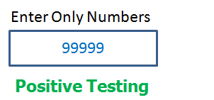
Positive Testing and Negative Testing
Positive Testing:
Positive Testing is a type of testing which is performed on a software application by providing the valid data sets as an input. It checks whether the software application behaves as expected with positive inputs or not. Positive testing is performed in order to check whether the software application does exactly what it is expected to do.
There is a text box in an application which can accept only numbers. Entering values up to 99999 will be acceptable by the system and any other values apart from this should not be acceptable. To do positive testing, set the valid input values from 0 to 99999 and check whether the system is accepting the values.

Slide 4
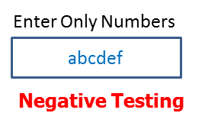
Positive Testing and Negative Testing
Negative Testing:
Negative Testing is a testing method performed on the software application by providing invalid or improper data sets as input. It checks whether the software application behaves as expected with the negative or unwanted user inputs. The purpose of negative testing is to ensure that the software application does not crash and remains stable with invalid data inputs.
Negative testing can be performed by entering characters A to Z or from a to z. Either software system should not accept the values or else it should throw an error message for these invalid data inputs.

Slide 5
Positive Testing and Negative Testing
Negative Testing:
Negative Testing is a testing method performed on the software application by providing invalid or improper data sets as input. It checks whether the software application behaves as expected with the negative or unwanted user inputs. The purpose of negative testing is to ensure that the software application does not crash and remains stable with invalid data inputs.

Slide 6
Positive Testing and Negative Testing
Testing Technique:
Following techniques are used for Positive and negative validation of testing is:
Boundary Value Analysis
Equivalence Partitioning
Boundary Value Analysis:
This is one of the software testing technique in which the test cases are designed to include values at the boundary. If the input data is used within the boundary value limits, then it is said to be Positive Testing. If the input data is picked outside the boundary value limits, then it is said to be Negative Testing.

Slide 7
Positive Testing and Negative Testing
Testing Technique:
Following techniques are used for Positive and negative validation of testing is:
Boundary Value Analysis
Equivalence Partitioning

Slide 8
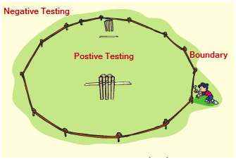
Positive Testing and Negative Testing
Boundary Value Analysis:
This is one of the software testing technique in which the test cases are designed to include values at the boundary. If the input data is used within the boundary value limits, then it is said to be Positive Testing. If the input data is picked outside the boundary value limits, then it is said to be Negative Testing.
For example -
A system can accept the numbers from 0 to 10 numeric values. All other numbers are invalid values. Under this technique, boundary values -1,0,1 and 9,10,11 will be tested.

Slide 9
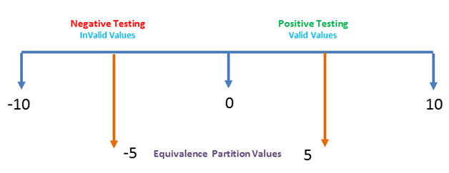
Positive Testing and Negative Testing
Equivalence Partitioning:
This is a software testing technique which divides the input data into many partitions. Values from each partition must be tested at least once. Partitions with valid values are used for Positive Testing. While partitions with invalid values are used for negative testing.

Slide 10
Positive Testing and Negative Testing
Equivalence Partitioning:
For example-
Numeric values Zero to ten can be divided into two (or three) partitions. In our case, we have two partitions -10 to -1 and 0 to 10. Sample values (5 and -5) can be taken from each part to test the scenarios.

Slide 11
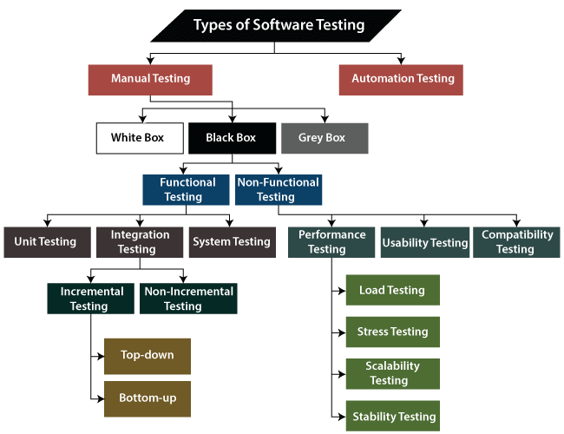
Types of Software Testing

Slide 12
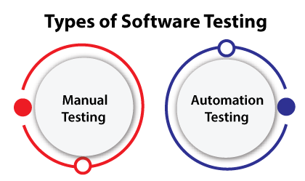
Types of Software Testing
The software testing mainly divided into two parts, which are as follows:

Slide 13
Types of Software Testing
Manual Testing:
One of the Software Testing Fundamental is "100% Automation is not possible". This makes Manual Testing imperative.
Manual testing is a software testing process in which test cases are executed manually without using any automated tool.
All test cases executed by the tester manually according to the end user's perspective.
It ensures whether the application is working, as mentioned in the requirement document or not.
Test cases are planned and implemented to complete almost 100 percent of the software application.
Test case reports are also generated manually.
Manual Testing is one of the most fundamental testing processes as it can find both visible and hidden defects of the software.

Slide 14
Types of Software Testing
Manual Testing:
The difference between expected output and output, given by the software, is defined as a defect.
Manual testing is mandatory for every newly developed software before automated testing.
This testing requires great efforts and time, but it gives the surety of bug-free software.
Manual Testing requires knowledge of manual testing techniques but not of any automated testing tool.
we can say that it is a procedure of verification and validation
Manual testing is used to verify the behavior of an application or software in contradiction of requirements specification.
The developer fixed the defects and handed it to the tester for retesting.

Slide 15
Types of Software Testing
Why we need manual testing:
If we don't want to face these kinds of problems, we need to perform one round of testing to make the application bug free and stable and deliver a quality product to the client, because if the application is bug free, the end-user will use the application more conveniently.
If the test engineer does manual testing, he/she can test the application as an end-user perspective and get more familiar with the product, which helps them to write the correct test cases of the application and give the quick feedback of the application.

Slide 16
Types of Software Testing
Types of Manual Testing:
There are various methods used for manual testing. Each technique is used according to its testing criteria. Types of manual testing are given below:
White Box Testing
Black Box Testing
Gray Box Testing
White-box testing:
The white box testing is done by Developer, where they check every line of a code before giving it to the Test Engineer. Since the code is visible for the Developer during the testing, that's why it is also known as White box testing.

Slide 17
Types of Software Testing
Types of Manual Testing:
Black box testing:
The black box testing is done by the Test Engineer, where they can check the functionality of an application or the software according to the customer /client's needs. In this, the code is not visible while performing the testing; that's why it is known as black-box testing.
Gray Box testing:
Gray box testing is a combination of white box and Black box testing. It can be performed by a person who knew both coding and testing. And if the single person performs white box, as well as black-box testing for the application, is known as Gray box testing.

Slide 18
Types of Software Testing
How to perform Manual Testing:
First, tester observes all documents related to software, to select testing areas.
Tester analyses requirement documents to cover all requirements stated by the customer.
Tester develops the test cases according to the requirement document.
All test cases are executed manually by using Black box testing and white box testing.
If bugs occurred then the testing team informs the development team.
The Development team fixes bugs and handed software to the testing team for a retest.

Slide 19
Types of Software Testing
Software Build Process:
Once the requirement is collected, it will provide to the two different team development and testing team.
After getting the requirement, the concerned developer will start writing the code.
And in the meantime, the test engineer understands the requirement and prepares the required documents, up to now the developer may complete the code and store in the Control Version tool.
After that, the code changes in the UI, and these changes handle by one separate team, which is known as the build team.

Slide 20
Types of Software Testing
Software Build Process:
This build team will take the code and start compile and compress the code with the help of a build tool. Once we got some output, the output goes in the zip file, which is known as Build (application or software).Each Build will have some unique number like (B001, B002).
Then this particular Build will be installed in the test server. After that, the test engineer will access this test server with the help of the Test URL and start testing the application.
If the test engineer found any bug, he/she will be reported to the concerned developer.

Slide 21
Types of Software Testing
Software Build Process:
Then the developer will reproduce the bug in the test server and fix the bug and again store the code in the Control version tool, and it will install the new updated file and remove the old file; this process is continued until we get the stable Build.
Once we got the stable Build, it will be handed over to the customer.

Slide 22
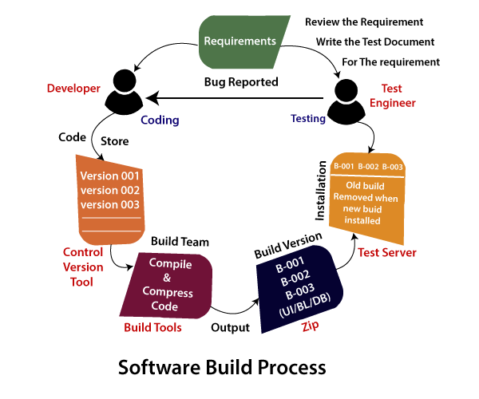
Types of Software Testing
Software Build Process:

Slide 23
Types of Software Testing
Advantages of Manual Testing:
It does not require programming knowledge while using the Black box method.
It is used to test dynamically changing GUI designs.
Tester interacts with software as a real user so that they are able to discover usability and user interface issues.
It ensures that the software is a hundred percent bug-free.
It is cost-effective.
Easy to learn for new testers.

Slide 24
Types of Software Testing
Disadvantages of Manual Testing:
It requires a large number of human resources.
It is very time-consuming.
Tester develops test cases based on their skills and experience. There is no evidence that they have covered all functions or not.
Test cases cannot be used again. Need to develop separate test cases for each new software.
It does not provide testing on all aspects of testing.
Since two teams work together, sometimes it is difficult to understand each other's motives, it can mislead the process.

Slide 25
Types of Software Testing
Manual testing tools:
In manual testing, different types of testing like unit, integration, security, performance, and bug tracking, we have various tools.
Jira
Bugzilla
Mantis
Zap
Nunit
Tessy
LoadRunner
Citrus
SonarQube.
They are available in the market. Some of the tools are open-source, and some are commercial.

Slide 26
Types of Software Testing
Automation testing:
Another software testing method is automation testing, which is used some specific tools to execute the test scripts without any human interference. It is the most acceptable way to enhance the efficiency, productivity, and test coverage of Software testing.
With the help of an automation testing tool, we can easily approach the test data, handle the test implementation, and compares the actual output against the expected outcome.
In automation testing, the test automation engineer will write the test script or use the automation testing tools to execute the application. On the other hand, in manual testing, the test engineer will write the test cases and implement the software on the basis of written test cases.

Slide 27
Types of Software Testing
Automation testing:
In test automation, the test engineer can execute repetitive tasks and other related tasks.
In other words, we can say that the main concentration of test Automation is to change the manual human activity with systems or devices.
The automation testing process is a time-saving process as it spends less time in exploratory testing and more time in keeping the test scripts whereas enhancing the complete test coverage.

Slide 28
Types of Software Testing
Why do we need to perform automation testing?
In software testing, automation testing is required to test the application because it offers us a better application with less effort and time.
Some organizations still perform only manual testing to test the application as those companies are not fully aware of the automation testing process.
But now, they are aware of automated testing and executing the test automation procedure in their application development process.
To implement the automation testing, we required pretty a considerable investment of resources and money.

Slide 29
Types of Software Testing
Why do we need to perform automation testing?
The execution of automation testing provides:
Reusability
Consistency
Running tests anytime (24/7)
Early Bug detection
Less Human Resources

Slide 30
Types of Software Testing
Why do we need to perform automation testing?
Reusability:
We can re-use the test scripts in automation testing, and we don't need to write the new test scripts again and again. And, we can also re-create the steps which are detailed as the earlier ones.
Consistency:
As compared to manual testing, automation testing is more consistent and way faster than executing the regular monotonous tests that cannot be missed but may cause faults when tested manually.

Slide 31
Types of Software Testing
Why do we need to perform automation testing?
Running tests anytime (24/7):
In automation testing, we can start the testing process from anywhere in the world and anytime we want to. And even we can do that remotely if we don't have many approaches or the option to purchase them.
Early Bug detection:
We can easily detect the critical bugs in the software development process's initial phases by executing automation testing. It also helps us spend fewer working hours to fix these problems and reduce costs

Slide 32
Types of Software Testing
Why do we need to perform automation testing?
Less Human Resources:
To implement the automation test script, we need a test automation engineer who can write the test scripts to automate our tests, rather than having several people who are repeatedly performing the tedious manual tests.

Slide 33
Types of Software Testing
Automation Testing Methodologies:
Automation testing contains the following three different methodologies and approaches, which will help the test engineer to enhance the software product's quality.
GUI Testing:
In this approach, we can implement that software or an application, which contains GUIs. So, that the automation test engineers can record user actions and evaluate them many times.
We know that the Test cases can be written in several programming languages like JAVA, C#, Python, Perl, etc.

Slide 34
Types of Software Testing
Automation Testing Methodologies:
Code-Driven:
In this method, the test engineer will mainly concentrate on test case execution in order to identify whether the several parts of code are performing according to the given requirement or not.
Hence, it is very a commonly used method in agile software development.

Slide 35
Types of Software Testing
Automation Testing Methodologies:
Test Automation Framework:
Another approach in automation testing is test automation framework. The test automation framework is a set of rules used to generate valuable results of the automated testing activity.
Similarly, it brings together test data sources, function libraries, object details, and other reusable modules.

Slide 36
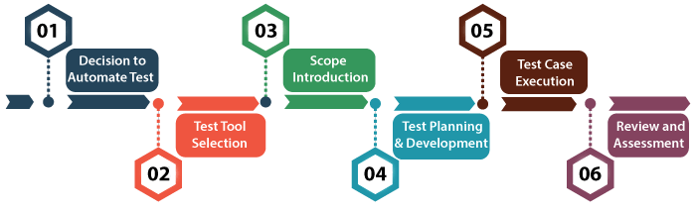
Types of Software Testing
Automation Testing Process:
Test Automation Framework:
The automation testing process is a systematic approach to organize and execute testing activities in a manner that provides maximum test coverage with limited resources. The structure of the test involves a multi-step process that supports the required, detailed and inter-related activities to perform the task.

Slide 37
Types of Software Testing
Automation Testing Process:
Step1: Decision to Automation Testing:
It is the first phase of Automation Test Life-cycle Methodology (ATLM). At this phase, the main focus of the testing team is to manage expectations from the test and find out the potential benefits if applying the automated testing correctly.

Slide 38
Types of Software Testing
Automation Testing Process:
Step2: Test Tool Selection:
Test Tool Selection represents the second phase of the Automation Test Life-cycle Methodology (ATLM). This phase guides the tester in the evaluation and selection of the testing tool.
Since the testing tool supports almost all testing requirements, the tester still needs to review the system engineering environment and other organizational needs and then make a list of evaluation parameters of the tools. Test engineers evaluate the equipment based on the provided sample criteria.

Slide 39
Types of Software Testing
Automation Testing Process:
Step3: Scope Introduction:
This phase represents the third phase of Automation Test Life-cycle Methodology (ATLM). The scope of automation includes the testing area of the application.
This phase ensures the overall testing strategy that should be well managed and modified if required. In order to ensure the availability of skills, testing skills of a particular member and whole team are analyzed against the required specific skills for a particular software application.

Slide 40
Types of Software Testing
Automation Testing Process:
Step4: Test Planning and Development:
Test planning and development is the fourth and most important phase of Automation Test Life -cycle Methodology (ATLM) because all the testing strategies are defined here. Planning of long -lead test activities, the creation of standards and guidelines, an arrangement of the required combination of hardware, software and network to create a test environment, defect tracking procedure, guidelines to control test configuration and environment all are identified in this phase. Tester determines estimated effort and cost for the entire project. Test strategy and effort estimation documents are the deliverables provided by this phase. Test case execution can be started after the successful completion of test planning.

Slide 41
Types of Software Testing
Automation Testing Process:
Step5: Test Case Execution:
Test case Execution is the sixth phase of Automation Test Life -cycle Methodology (ATLM). It takes place after the successful completion of test planning. At this stage, the testing team defines test design and development. Now, test cases can be executed under product testing. In this phase, the testing team starts case development and execution activity by using automated tools. The prepared test cases are reviewed by peer members of the testing team or quality assurance leaders.
During the execution of test procedures, the testing team directed to comply with the execution schedule. Execution phase implements the strategies such as integration, acceptance and unit testing that have defined in the test plan previously.

Slide 42
Types of Software Testing
Automation Testing Process:
Step6: Review and Assessment:
Review and assessment is the sixth and final stage of the automated testing life cycle but the activities of this phase are conducted throughout the whole life cycle to maintain continuous quality improvement. The improvement process is done via the evaluation of matrices, review and assessment of the activities.
During the review, the examiner concentrates whether the particular metric satisfies the acceptance criteria or not, if yes, then it is ready to use in software production. It is comprehensive as test cases cover each feature of the application.

Slide 43
Types of Software Testing
What are different challenges faced during the Automation testing process, and how to overcome them?
The automation testing process carries about large numbers of advantages for an organization. Usually, with automated testing, the testing team of the specified method of software validation can accomplish the amplified test coverage.
Though we may face various challenges during the automation testing process; therefore, we need a thorough follow-up process to reach successful test automation execution.
Some of the common challenges are as discuss, which we might encounter throughout the test automation process of an application

Slide 44
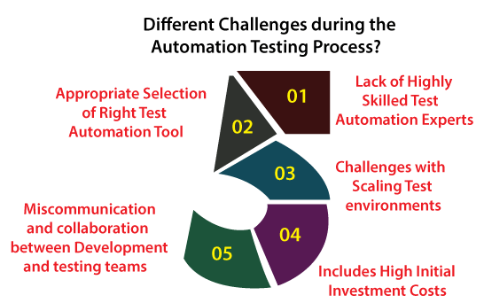
Types of Software Testing
What are different challenges faced during the Automation testing process, and how to overcome them?

Slide 45
Types of Software Testing
Advantages of Automation Testing:
Automation testing takes less time than manual testing.
A tester can test the response of the software if the execution of the same operation is repeated several times.
Automation Testing provides re-usability of test cases on testing of different versions of the same software.
Automation testing is reliable as it eliminates hidden errors by executing test cases again in the same way.
Automation Testing is comprehensive as test cases cover each and every feature of the application.
It does not require many human resources, instead of writing test cases and testing them manually, they need an automation testing engineer to run them.
The cost of automation testing is less than manual testing because it requires a few human resources.

Slide 46
Types of Software Testing
Disadvantages of Automation Testing:
Automation Testing requires high-level skilled testers.
It requires high-quality testing tools.
When it encounters an unsuccessful test case, the analysis of the whole event is complicated.
Test maintenance is expensive because high fee license testing equipment is necessary.
Debugging is mandatory if a less effective error has not been solved, it can lead to fatal results.

Slide 47
Types of Software Testing
Automation Testing Tools:
Automation testing tools can describe in two categories, which are as follows:
Functional Testing Tools
  Commercial Tool
    QTP[Quick Test Professional]
    Rational Functional Tester [RFT]
    TestComplete
    SoapUI
  Open-source Tool
    Selenium
    Sikuli
    Autoit
Non-Functional Testing Tools
  Commercial Tool
    LoadRunner
    Silk Performer
  Open-source Tool
    JMeter
    NeoLoad

